Slide 1
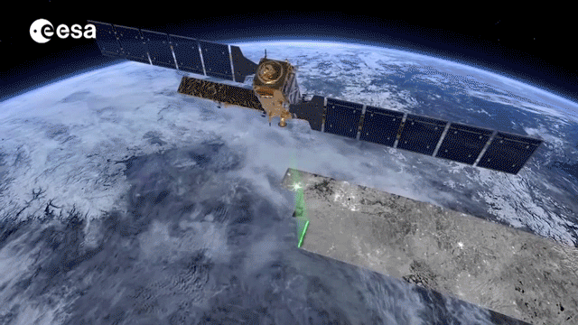
S1Tiling sentinel-1 Pre-Processing
V 1.1
Thierry KOLECK CNES – DTN/TPI/TR
Luc HERMITTE CS-Group

Slide 2
Objectives
Sentinel-1 was the first SAR system providing free data on large time and space domain
New opportunities for research and business
Generic processing chain for Sentinel-1 time series
Building ready-to-use times series of Sentinel-1 images (Analysis Ready Data)
Need for many projects
Open-source and OTB based
Focused on efficient processing for large time series and large areas

Slide 3
Sentinel-1 Observation Scenario
Two satellites (S1-A and S1-B) with a C-band Synthetic Aperture Radar payload.
S1A (October 2014) and S1B (September 2016 -> December 2021)
S1C (December 2024)
12-days repeat cycle (6 days with 2 phased satellites)
Full and systematic coverage of lands
Dual polarizations
All-weather sensor: Not sensitive to clouds
True time-serie data (no loss of data during rainy season)
3

Slide 4
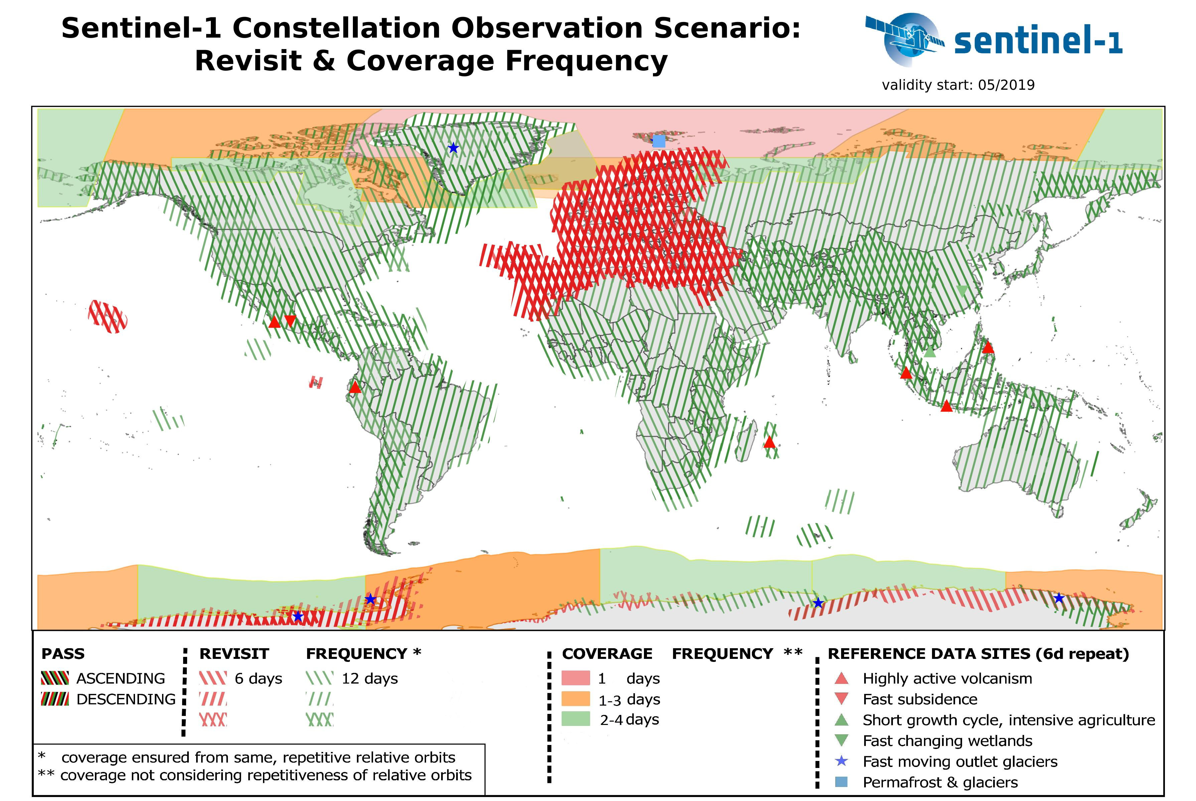
Sentinel-1 Observation Scenario

Slide 5
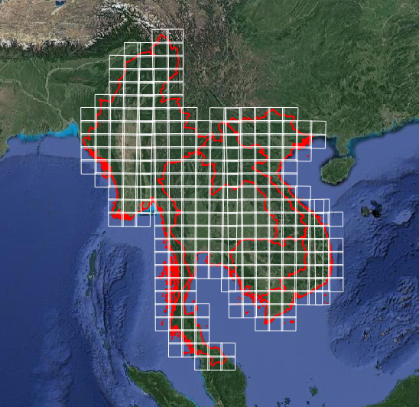
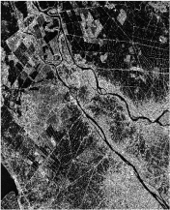
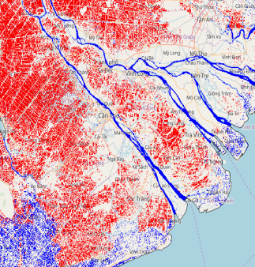
How to use sentinel-1 time series
Two major steps:
1. S1 data pre-processing
Building the calibrated, orthorectified (GTC), corrected (RTC), speckle filtered time series over the area of interest (as in datacube)
2. Time series analysis for product generation
Time series analysis
time
Product generation
Product display

Slide 6
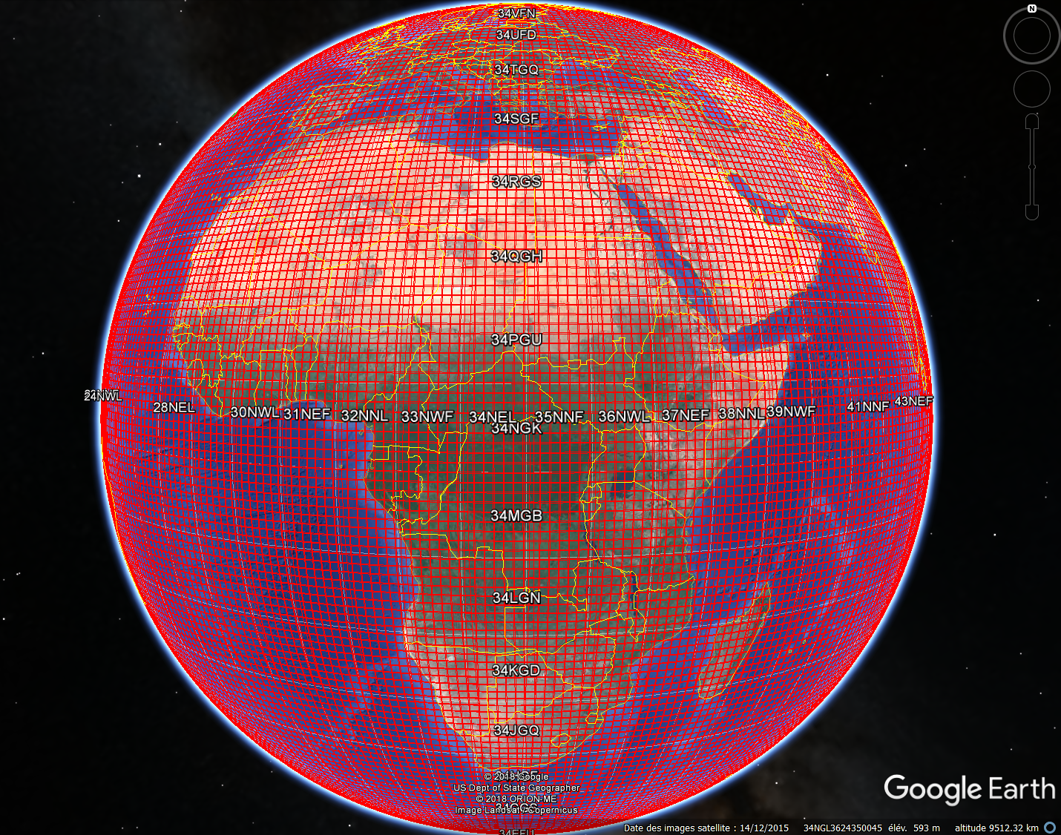
S1tiling: an ARD Processing Chain for S1
MGRS
Multipurpose
No geographic limitation
Fully customizable
Operationnal
Pipeline of processings
Automatic processing, error management, optimized restarting
Optimal disk management
Portable
From laptop to high-performance cluster
Developed with open source softwares
Easy installation
Efficient
Parallel processing (multiprocesses and multithreading)
MGRS tile: 110x110 km
also used for Sentinel-2 products

Slide 7
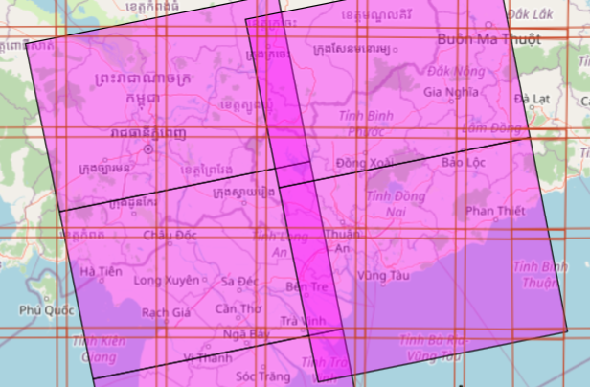
2 GRD products / date
1 GRD product / date
red: MGRS tiles purple: GRD products

Slide 8
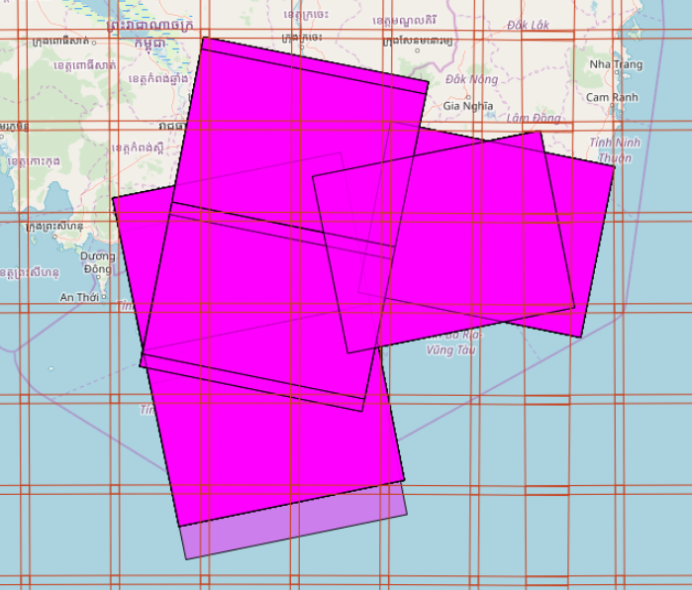
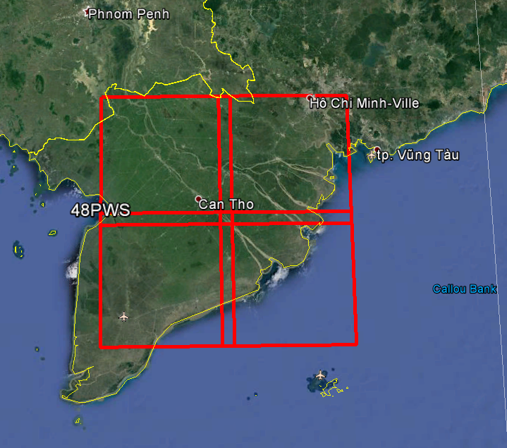
Processing
S1 GRD images
Orthoimages
Step 1
Step 2
Downloading
Calibration, projection,
concatenation
Série temporelle filtrée
Etape 3
Speckle
Filering
ROI

Slide 9
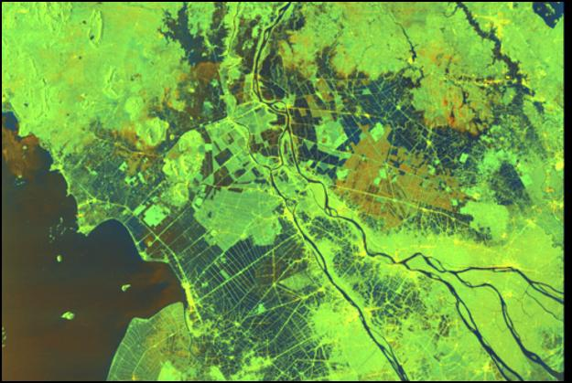
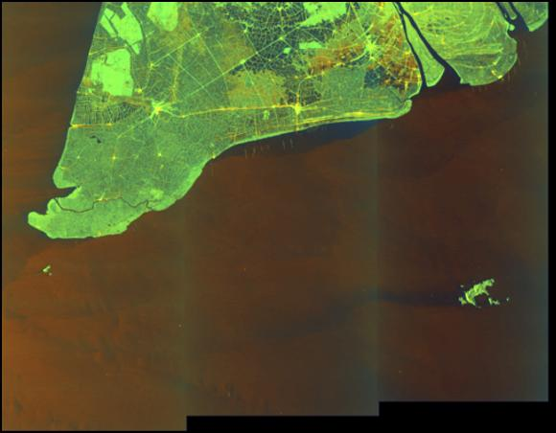
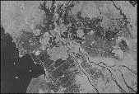
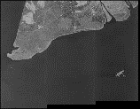
S1Tiling pipeline
1- Request the product list to be processed (for 1 tile)
2- Analyze and build the task tree
3- Download products to be processed
4- Execute the processing pipelines into Dask
Pipeline
Calibration
Calibration
Analyze border
Analyze border
Cutting border
Cutting border
Ortho-ready images
Orthorectification
Orthorectification
Mask generation
Mask generation
Concatenation

Slide 10
How to use it ?
[Paths]
# Path for result tiled images
output : /work/scratch/koleck/data_out
# Path to store the S1 images to be processed
s1_images : %(TMPDIR)s/s1tiling/S1
# Path to SRTM files
dem_dir : /work/datalake/static_aux/MNT/SRTM_30_hgt
# Path to a temporary file
tmp : %(TMPDIR)s/s1tiling
[DataSource]
Download : True
nb_parallel_download: 2
polarisation : VV-VH
first_date : 2020-01-07
last_date : 2020-01-09
tile_to_product_overlap_ratio: 5
[Processing]
# Define the type of calibration: gamma, beta, sigma or normlim
Calibration: gamma
# Remove thermal noise
remove_thermal_noise: True
# Pixel Size (in meters) of the output images
OutputSpatialResolution : 10.
Tiles: 19LHK, 19PGM
nb_parallel_processes : 5
nb_otb_threads: 2
ram_per_process : 4096
produce_lia_map: True

Slide 11
How to use it ?
Usage: S1Processor [OPTIONS] CONFIG_FILENAME
On demand Ortho-rectification of Sentinel-1 data on Sentinel-2 grid.
It performs the following steps: 1. Download S1 images from S1 data
provider (through eodag) 2. Calibrate the S1 images 3.
Orthorectify S1 images and cut their on geometric tiles 4. Concatenate
images from the same orbit on the same tile 5. Build mask files
Parameters have to be set by the user in the S1Processor.cfg file
Options:
--version Show the version and exit.
--cache-before-ortho / --no-cache-before-ortho
Force to store Calibration|Cutting result on disk before orthorectification.
BEWARE, this option will produce temporary files that you'll need to
explicitely delete.
--searched_items_per_page INTEGER
Number of products simultaneously requested by eodag
--dryrun Display the processing shall would be realized, but none is done.
--debug-otb Investigation mode were OTB Applications are directly used without Dask in
order to run them through gdb for instance.
--watch-ram Trigger investigation mode for watching memory usage
--graphs Generate SVG images showing task graphs of the processing flows

Slide 12
How to use it ?
Output: one folder per tile
47PRP 47QPV 47QQF 47QRE 48PTT 48PUS 48PVQ 48PWA 48PWV 48PXT 48PYS 48PZC 48QTF 48QUE 48QUL 48QVJ 48QWH 48QXF 48QYD 48QZJ
For each tile:
s1a_48PYS_vh_ASC_128_20180701t110305.tif s1a_48PYS_vh_DES_120_20180712t223707.tif s1a_48PYS_vv_DES_018_20180705txxxxxx.tif s1b_48PYS_vh_DES_018_20180723txxxxxx.tif s1a_48PYS_vh_ASC_128_20180713t110306.tif s1a_48PYS_vh_DES_120_20180724t223707.tif s1a_48PYS_vv_DES_018_20180717txxxxxx.tif s1b_48PYS_vh_DES_018_20180804t224455.tif s1a_48PYS_vh_ASC_128_20180725t110307.tif s1a_48PYS_vh_DES_120_20180805t223708.tif s1a_48PYS_vv_DES_018_20180729t224509.tif s1b_48PYS_vv_DES_018_20171008txxxxxx.tif s1a_48PYS_vh_ASC_128_20180806t110307.tif s1a_48PYS_vv_ASC_128_20171010t110303.tif s1a_48PYS_vv_DES_018_20180810txxxxxx.tif s1b_48PYS_vv_DES_018_20171020txxxxxx.tif s1a_48PYS_vh_DES_018_20171002txxxxxx.tif s1a_48PYS_vv_ASC_128_20171022t110304.tif s1a_48PYS_vv_DES_120_20171009t223704.tif s1b_48PYS_vv_DES_018_20171101txxxxxx.tif

Slide 13
Inside S1Tiling
S1Tiling in Python 3
EODAG for data provider management
Access to many data provider
Catalog request and downloading
OTB for building in-memory pipelines (calibration, remove-border, masking, ortho, ….)
Pipeline can be executed in memory or with intermediary files writing
DASK for running pipelines in parallel
Only on one computer node

Slide 14
Distribution
Sources: https://gitlab.orfeo-toolbox.org/s1-tiling/s1tiling
PiPy: https://pypi.org/project/S1Tiling/
Documentation: https://s1-tiling.pages.orfeo-toolbox.org/s1tiling/latest/
S1Tiling docker image available

Slide 15
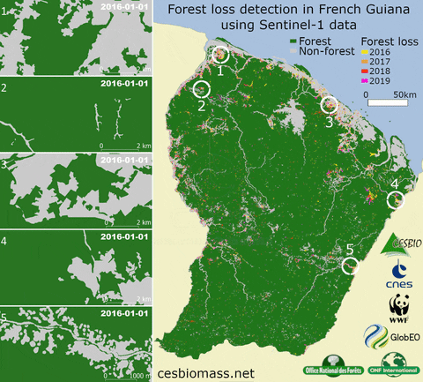
User projects
TropiSCO : Near real time deforestation
Brazilian Amazonia, Guiana shield, France, SE Asia, Gabon
Brazil: 225.000 images
Gabon: 22.000 images
SE Asia: 210.000 images
Guiana Shield: 44.000 images

Slide 16
