Slide 1
PEPS and data processing
ERWANN poupart
software ground system ENGINEER at CNES, Toulouse, France
Responsible for PEPS DATA processing architecture

Slide 2
outline
Peps hpss data storage statistics
Peps data processing today and in the near future

Slide 3
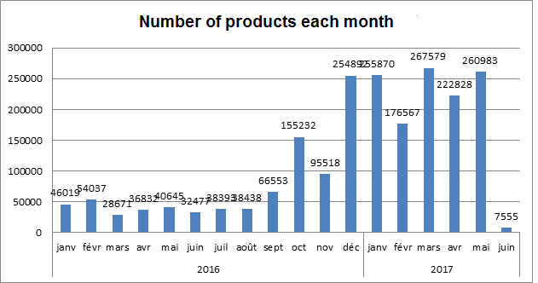
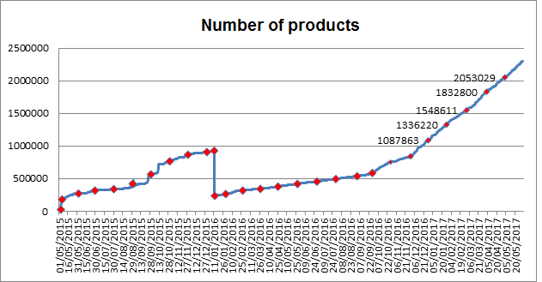
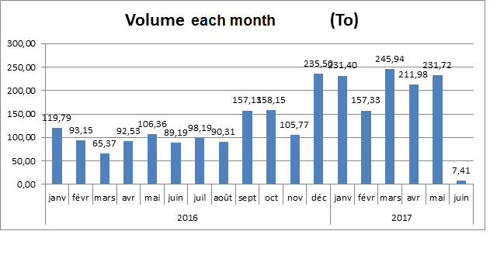
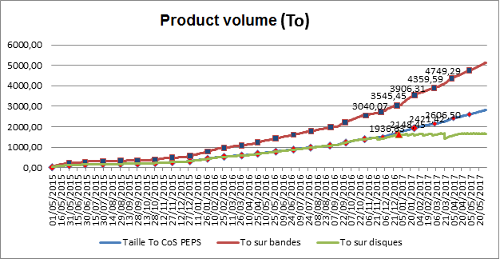
PEPS HPSS STORAGE statistics

Slide 4
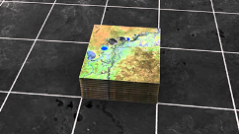
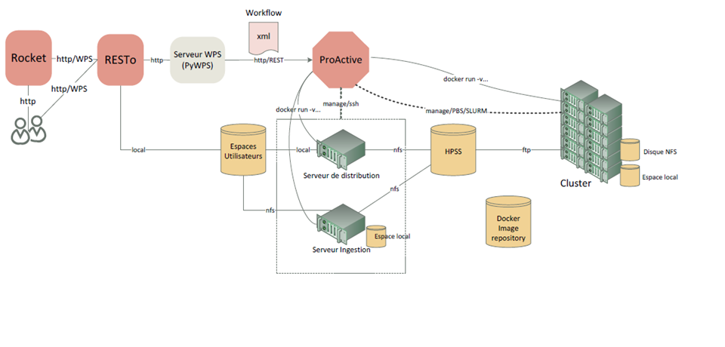
PEPS DATA PROCESSING ARCHITECTURE
PEPS process request
PEPS Data & Services

Slide 5
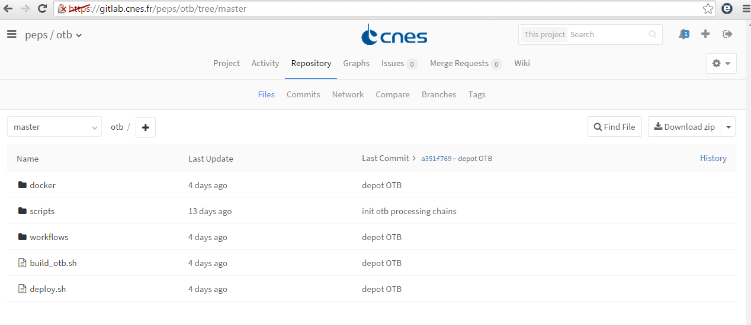
PEPS processing chains ON GITLAB : OTB is “dockerized”
ORTHO_S1_GRD.xml
QL_S2.xml
Launch

Slide 6
peps processing in the future
PEPS V2 with new processing GUI : to come in September 2017
Current prototypes development using datacube V2 : https://www.ceosdatacube.org
To come : experimentation using datacube & Spark/Hadoop API

Slide 7
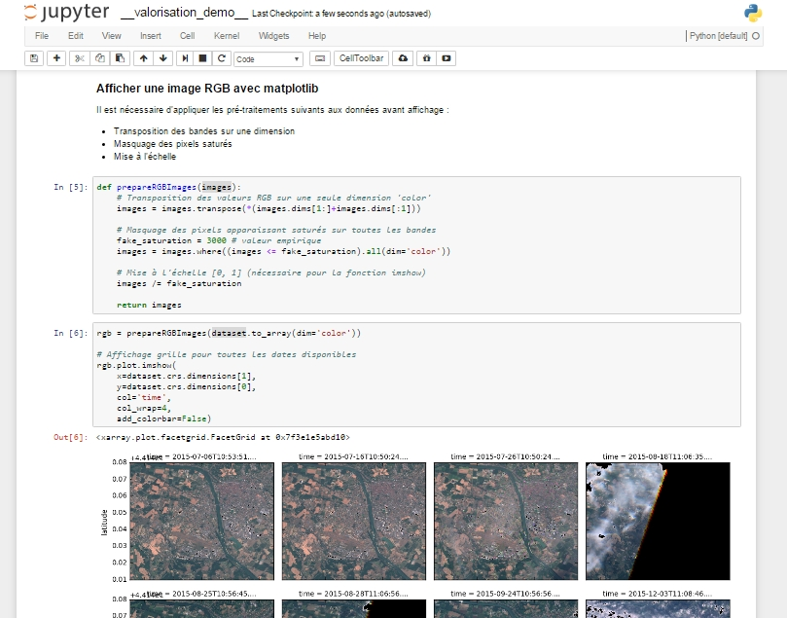
JUPYTER notebook data cube experimentation in 2017
Demo.pdf

Slide 8
peps processing in the future
Any Questions ?

